Slide 1
Chapter 9: Model evaluation and validation

Slide 2
Contents
Introduction
Evaluate Palette
Model Validation
Model Analyzer

Slide 3
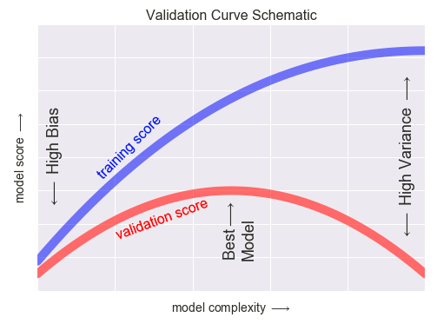
Goal of Validation
To assess whether rules/segments are applicable to the population
Prior to modelling – partition data: Training and Validation partitions
Build model and do first-level evaluation on the Training partition
More thorough evaluation and validate done on the Validation partition
  Purpose: test how well a model performs on “new” data
  Validation or testing dataset acts as a proxy for the population
Notes:
What’s the point of model validation and evaluation?
The general point is to assess the rules and segments you’ve found using your model and apply to the whole population. Often this is called something like over-fit.
So what’s you are worried about happening, is that, you build a model on some subset of the population. Then the model you build make perfect sense on that; but it works because of some arbitrary pattern that are just sort of in that population by random chance. So when you start adding new records, patterns don’t apply at all!
To avoid this, before modeling, we partition data. We’ve already done this earlier in our demonstration.
The idea is, that you are going to evaluate your model on development partition but you are going to save a holdout sample called the Validation partition. And the goal is to use that Validation dataset as a proxy for the general population.
So you want to test how well your model works on that Validation dataset and that’s your proxy for how well your model performs on a separate data.
Now, in general, the standard goal is to have out of time data. So you would like your separate dataset to be in a different time period. That’s not always possible, and that’s why we use this evaluation validation proxy. If you have out of time data it’s even better.

Slide 4
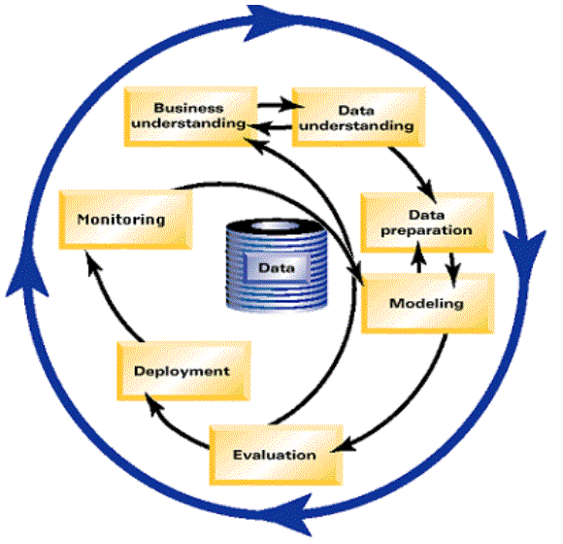
Reminder: CRISP - DM
Collect, describe, explore and verify quality of data
Determine business objectives and data mining goals
Select, clean, construct, integrate and format data
Champion/
Challenger
Select, generate, build and evaluate models
Integrate into
business processes
Evaluate how results
achieve business objectives
Notes:
Just a reminder about CRISP-DM approach, This is part of the approach after you are doing modeling, you go to evaluation. What you don’t do, you don’t go back. If we see in evaluation that things don’t do well, you should not go and make minor adjustment. You should go back to business understanding or at least go back to data preparation and start over.
If the best model you could build before doing evaluation, does not evaluate well, It means you did not understand something about your data properly. Maybe you chose the wrong model type and that means you had the bad choice at the beginning of the process and you should go back and revisit before just switching the model type.

Slide 5
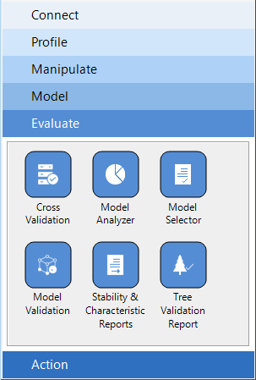
Model Evaluation Palette
In this course, we’ll focus on Model Validation and Model Analyzer nodes
Notes:
So what nodes are available in KS for model evaluation and validation…
There two that we are going to focus on in this course. Model Validation and Model Analyzer.
Model Validation is the first step and you are generating some scoring fields which are going to be used further in the analyzer and also to give you a report with some statistics about how well the model is doing.
Then there is the Model Analyzer, which is going to be used to give you a series of graphs and statistics. So you visually understand how your model is doing and how that impacts your business decisions that you plan to make.
There is also something called the Tree Validation Report, which I am going to let you try if you are interested, it basically gives you a version of decision tree where it shows you the difference in every node between the training and then testing partition.
We are going to focus on Model Validation and Model Analyzer.

Slide 6
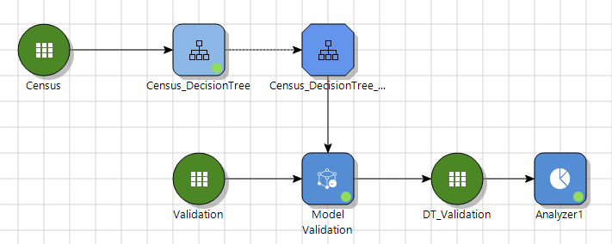
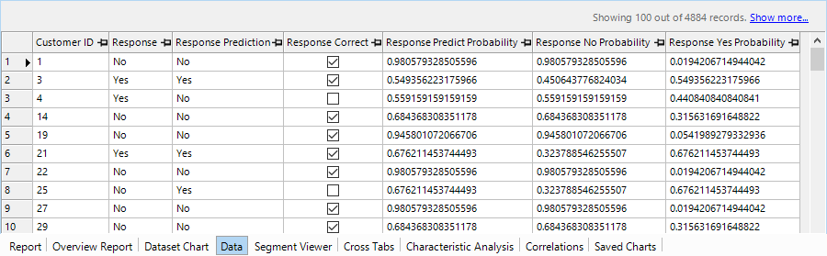
Model Validation
Connect model and validation dataset to the Model Validation node
Wizard contains:
  Field mapping
  Output options
Output: new dataset with scored fields with an additional Report tab

Slide 7
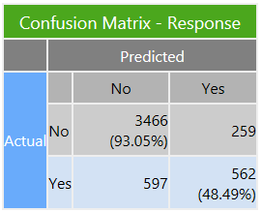
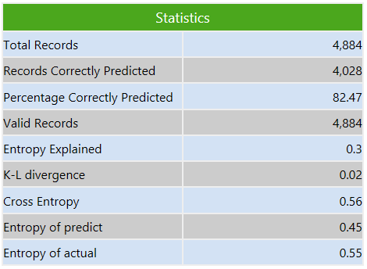

Model Validation Node
Report contains:
  Confusion Matrix (for categorical DVs only)
  Statistics table
The Confusion Matrix provides a count of Predicted and Actual values in each category pair
Actual values represent the known dependent variable outcomes, whereas the predicted values represent the predicted outcomes based on the model
Summing the values in the diagonal; i.e. the correct classifications, and dividing by the total number of cases; returns the correct classification rate
$$\frac{3466+562}{4884} ×100=82.47$$
Notes:
The output of model validation report is in two halves.
One of them looks like this thing on the left and the other one looks like this thing on the right.
There are some interesting statistics in here that tells you the total number of records in your dataset, and the number of valid records in your dataset. So you can tell if there were any record that there is not any valid prediction for. Also the number of correctly predicted records in the model and the percentage. Which is called Accuracy. There are few other statistics as well that I am not going to explain.
There is also a confusion matrix. The confusion matrix tells you the number of True positives and True negatives you’ve got. I’m gonna add some terminology in a minute. Basically, it’s going to give you some accuracy statistics on both the goods and the bads in your dataset. Or both the Yeses and the Nos. And that’s good because remember that we said our baseline, for how good your model is going to be, well we can pick an intercept only model, and if 75% of the data is no, our intercept only model is going to be right 75% at a the time. But what we usually care about is predicting the rare category. Predicting the Yeses in this case. So we care on how good of job the model is going on Yes category. That’s really important.

Slide 8
Model Analyzer
The Model Analyzer allows you to:
  Graphs and statistics to asses model accuracy
  Evaluate models with either a discrete dependent variable (DV) or a continuous DV
  Use some common metrics to look at model performance
  Compare results from a single model on training data with those on validation data
  Compare different models
Notes:
The Model Analyzer is a valuable tool for model evaluation & comparing models applied to the same dependent variable.
Most analysts and business users focus on a selected number of graphs while others may use more.

Slide 9
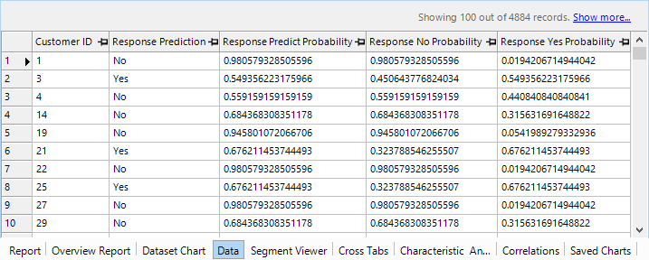
Model Analyzer
To use Model Analyzer, you must have a dataset with prediction probabilities (e.g. the results of a model validation node)

Slide 10
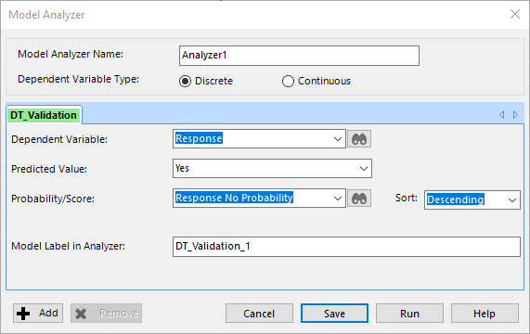
Model Analyzer
Dependent Variable (DV)
DV Category to be predicted
Prediction probability

Slide 11
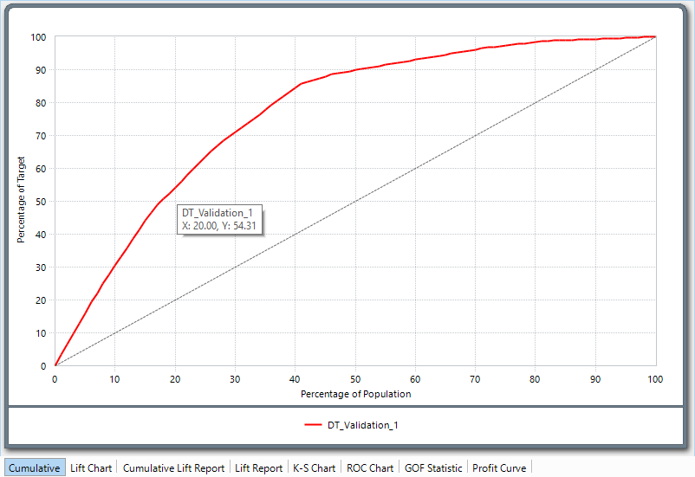
Cumulative lift
Selecting the top 20% based on the model predicted scores, would contain approximately 34% better than chance.
The Cumulative lift chart compares model performance to random selection.
Percentage of total outcome target category
Percentage of population sorted by model scores
Notes:
The Cumulative gains chart compares model performance to random selection.
The horizontal x-axis refers to the Percentage of Population selected.
The vertical y-axis refers to the Percentage of Target hit.
The graph shows the proportion of those in the target category contained in the percentage of the population selected. Here the target category is the Yes category of the Dependent Variable Response.
The diagonal line represents pure chance or random selection, i.e.: if 50% are randomly selected, it should contain 50% of the total number of those in the Yes category, and conversely 50% of the total number of those in the No category also. The curve reflects model performance. Selecting the top 40% based on the model predicted scores would contain approximately 86% of the total number of those in the Yes category. In this case the model is performing approximately 46% better than chance.

Slide 12
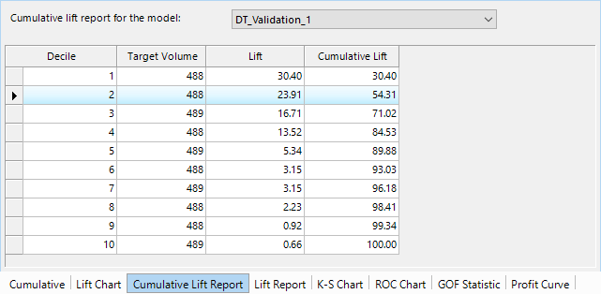
Cumulative Lift Report
The Cumulative Lift Report tab provides the same information in tabular form. This table gives the Model lift in decile increments
  The 2nd decile shows the value identified from the Cumulative Lift chart
Number of records per decile

Slide 13
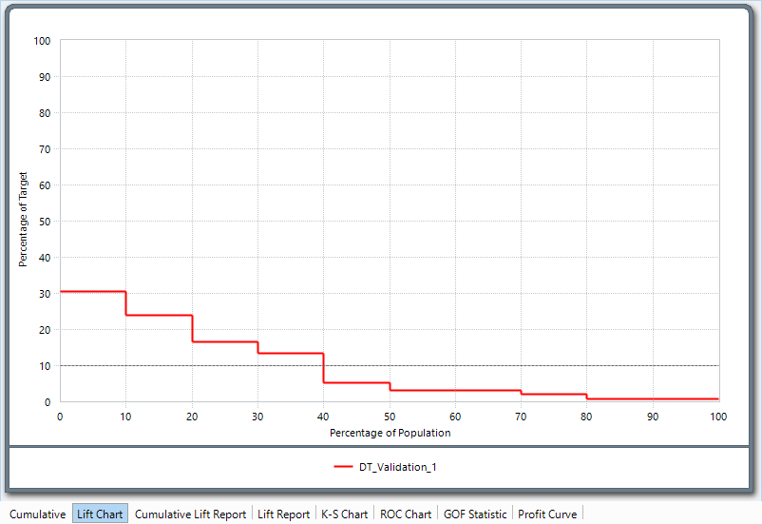
Lift Chart
The Lift Chart is a scaled ratio representation of model performance versus random selection at each decile.
reflects the point at which model performance is no better than random selection
Useful for detecting hidden problems with the model
Lift of the model at 1st decile
Notes:
The Lift Chart tab shows the lift chart for the model versus random selection.
It is a scaled ratio representation of model performance versus random selection at each decile.
The interpretation of the Lift Chart is straightforward.
For example: If I choose the top 10%, my model is more than three times as likely to identify a Yes category member, than random selection.
The intersection of the model line and the random selection line reflects the point at which model
performance is no better than random selection. This happens at approximately the 40th percentile.
This information is also given in tabular form on the Lift Report tab.
This chart is also useful for detecting hidden problems with the model. The model when plotted should be a monotonically decreasing function, i.e. each decile should have a lower lift than the previous decile. If this is not the case, i.e. the lift decreases and then subsequently increases, then the model should be treated with caution and not used.
NOTE: You can see there is a horizontal line drawn at the value 10 - why? This line represents random selection, which always has a 1/1 ratio.

Slide 14
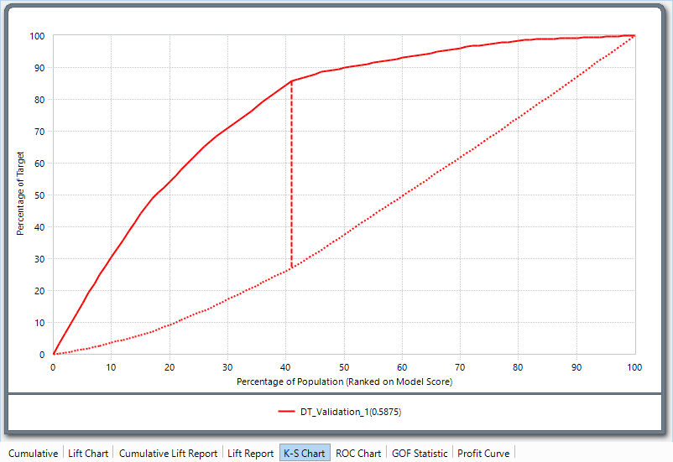
Kolmogorov-Smirnov Curve
The Kolmogorov-Smirnov curve shows the cumulative distribution of the dependent variable categories
The K-S statistic measures the difference between the two functions and returns the maximum value, which is where the model maximizes separation between Yes and No categories
(85.81 - 27.06)/100 = 0.5875
Notes:
The Kolmogorov-Smirnov curve shows the cumulative distribution of the dependent variable categories. The K-S statistic measures the difference between the two functions and returns the maximum value, which is where the model maximizes separation between Yes and No categories.
The K-S statistic is also reported in brackets to the right of the model name, and ranges from 0 (random scores) to 1 (perfectly predicted scores).
Here the maximum value of the K-S statistic is 0.5875. This is calculated as the difference between the Percentage of Target value for each of the curves at the maximum separation point; (85.81 - 27.06)/100 =
0.5875.
The optimum population selection percentage based on the model is approx. 41%, i.e. selecting the top 41% as identified by the model will give the greatest separation between No and Yes.
NOTE: A criticism of the K-S statistic is that the costs of misclassification are equal; this means that missing a Yes responder has the same penalty as targeting a No. In reality, this is often not the case in practice.

Slide 15
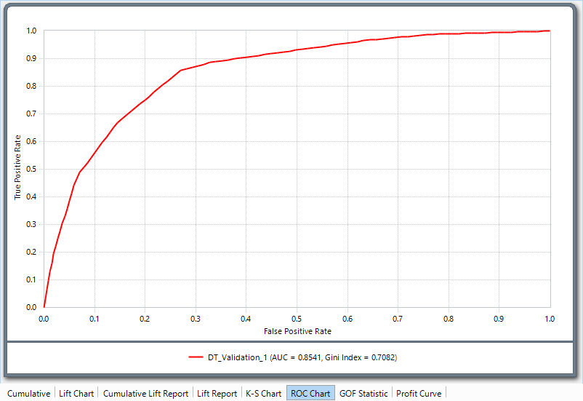
ROC Chart
The ROC Chart, Receiver Operating Characteristic, compares the True Positive Rate to the False Positive Rate as the discriminant, or classification threshold changes
The area under the curve is known as the AUC or C-Statistic
This ranges between 0.5 (for random
classification) and 1 (for perfect classification)
Demo
Specificity = TN / (TN + FP)
False Positive Rate = FPR = FP / (TN +FP) = 1 – Specificity
Sensitivity = Recall = True Positive Rate = TP / (TP + FN)
Notes:
We define some terms first.
Confusion matrix looks like this with some numbers in it.
There are actual values for the records and also predicted values.
There are four possible outcomes from a binary classifier. If the outcome from a prediction is No and the actual value is also No, then it is called a true negative (TN); however if the actual value is Yes then it is said to be a false negative (FN). Conversely, a true positive (TP) has occurred when both the prediction outcome and the actual value are Yes, and false positive (FP) is when the prediction outcome is Yes while the actual value is No.
- Sensitivity defined as True Positive rate= How many correct positive results are selected and it’s number of True Positive divided by number of people who are actually positive
-We also have false positive rate which is number of false positives divided by true negative plus false negative and we call that 1-specificity . How many incorrect positive results occur among all negative samples
-Specificity is true negative divided by true negative plus false positive= How many negative selected elements are truly negative
Now that ROC curve plot the Sensitivity versus 1-specificity, and we use this chart and it tells me for example if I want to achieve a sensitivity of at least 80% what false positive rate I must put up with in order to gain that true positive rate.
In many business context that’s a very good question to ask.
For example , this ROC chert shows, to obtain an accuracy of 80% for the Yes means 23% of the No category will be misclassified.
The area under the curve is known as the AUC or C-Statistic. This ranges between 0.5 (for random
classification) and 1 (for perfect classification).
The AUC here is 0.8541 which is more than adequate for a reliable model.
The Gini Index is also displayed and is equal to (2 ×AUC) −1. The Gini Index is no better or worse than
the AUC statistic, but ranges between 0 and 1 instead of 0.5 and 1.
So let’s go to the software.
##Precision = TP/TP+FP
##An appropriate example in a real-world problem, consider a diagnostic test that seeks to determine whether a person has a certain disease. A false positive in this case occurs when the person tests positive, but does not actually have the disease. A false negative, on the other hand, occurs when the person tests negative, suggesting they are healthy, when they actually do have the disease.

Slide 16
Chapter 9 Exercises
Using the Automatic Grow option or a tree, assess model accuracy using Resubstitution from the Tools menu
Using the Model Validation node, generate a validated dataset containing the statistical report and Confusion Matrix
  What is the classification rate for each of the categories of the dependent variables?
  Look at the Overview Report and Data tabs. What new variables have been created, and what are they?
Evaluate the model by connecting the validated dataset from the previous step to the Model Analyzer node. Ensure you select the Yes category of the dependent variable, and the Yes Prob from the validated dataset
Assess each graph in turn ensuring you understand what it means
Considering all of these charts, what is the optimum cut-off point in this model?
Use the Tree Validation Report node to apply the model created with the Development partition to the Validation partition. Produce a Validation Report
Use the Model Analyzer to assess how well the model performs on the Validation partition
  Do the curves look similar?
  Do you think the model validates? Use the shape of the curves and the generated statistics to assess
Use the Variable Importance node from the Profile palette to determine ranked variable importance.

